Slide 1

Azure Financial Control
Wojciech Pazdzierkiewicz – Infrastructure Architect
Besim Bislimi – Global IT Senior Systems Manager

Slide 2
Table of contents
On-boarding workload
Cost governance
Regular reviews
Campaign reviews
Optimize enterprise costs
Appendix
Tools
Azure spending limit
Integration
Framework template
Reference articles

Slide 3
On-boarding workload

Slide 4
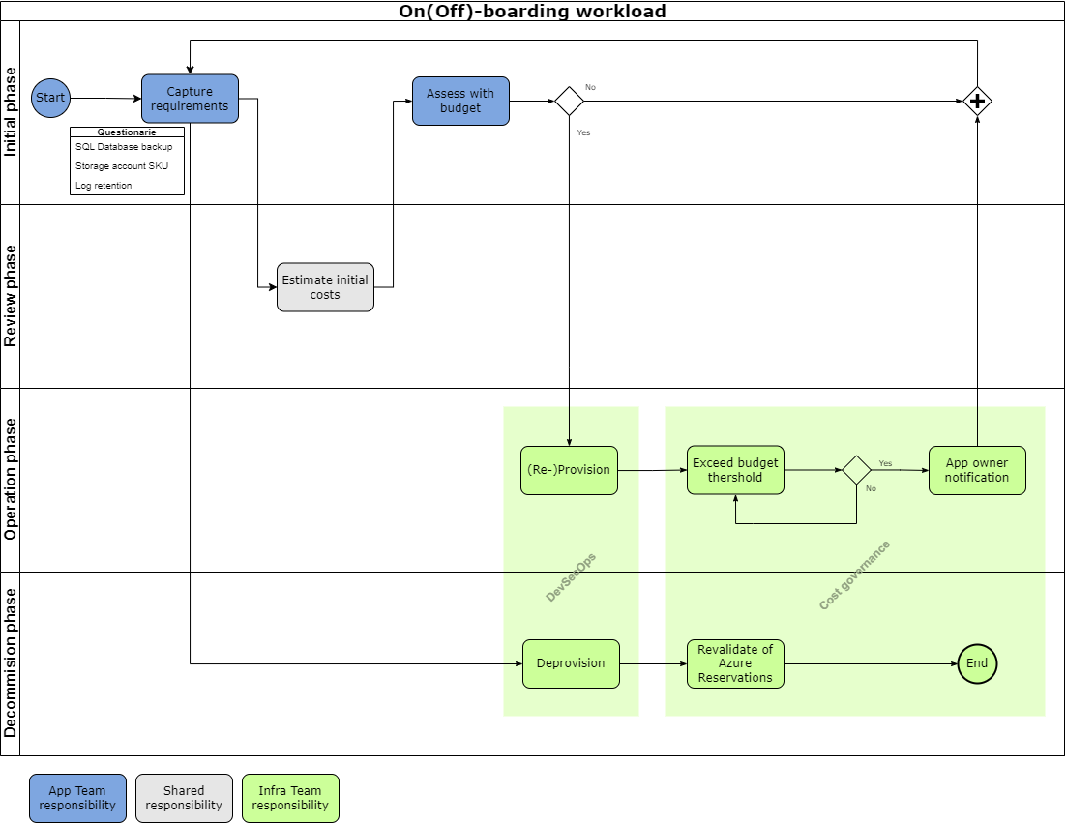
On-boarding workload - process
Principals:
Choose the correct resources
Set up budgets and maintain cost constraints
Dynamically allocate and de-allocate resources
Optimize workloads, aim for scalable costs
Continuously monitor and optimize cost management

Slide 5
On-boarding workload – questionnaire
Area | Topic | Defaults
Architecture: Resource properties | Subscription | DUFRY DEV/TEST/POC
 | Region | West Europe
 | SKU | basic
 | Backup retention | 30 days
 | Redundancy | zoning / availability set
Service management | SLA | 99,9%
 | Licensing | Azure Hybrid Benefit
 | Tag values | <default>
 | Budget thresholds | Actual: 90% Forecasted: 100%
 | Communication matrix | App owner email address
Operation options | Re-use shared services | Ex. AKS
 | Expected workload | <metric>
 | Regular or periodical run | Auto-shutdown: yes
 | Approx. workload grow | 10%

Slide 6
2
Cost governance

Slide 7
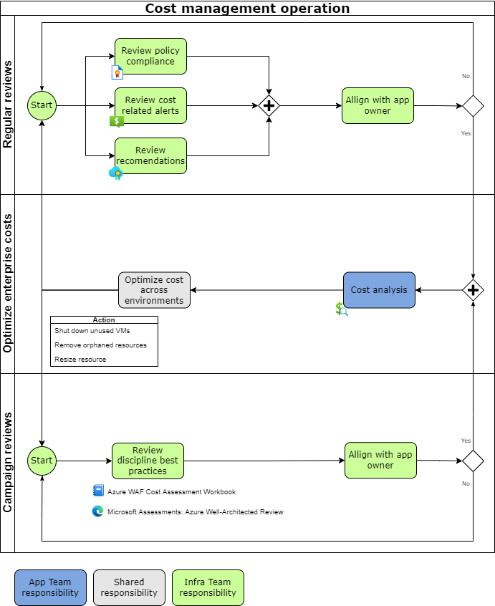
Cost governance
The Cost Management discipline of cloud governance focuses on establishing budgets, monitoring cost allocation patterns, and implementing controls to improve cloud spending behaviors across the IT portfolio.
Governance operation areas:
Regular reviews
Continuously monitor cost usage
Compare with strategy
Campaign reviews
Review best practices
Perform analytics
Align / Improve a strategy
Optimize enterprise costs
Align with app owners
Implement recommendation

Slide 8
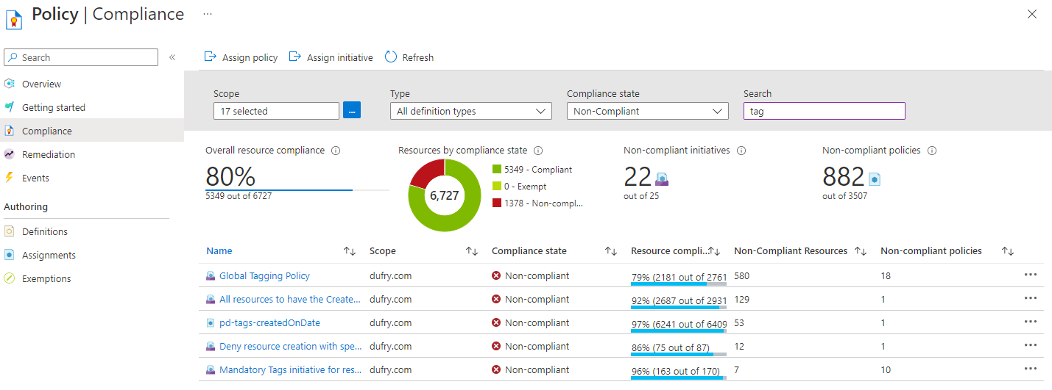
Cost governance – regular reviews: policy compliance
As tags are the basis for tracking costs with Cost Management, Azure Policy is used to enforce tagging rules and conventions. By creating a policy, we avoid the scenario of resources being deployed to a subscription that don't have the expected tags for organization. Instead of manually applying tags or searching for resources that aren't compliant, we create a policy that automatically applies the needed tags during deployment.
Policy definitions for tagging resources - Azure Resource Manager | Microsoft Learn

Slide 9
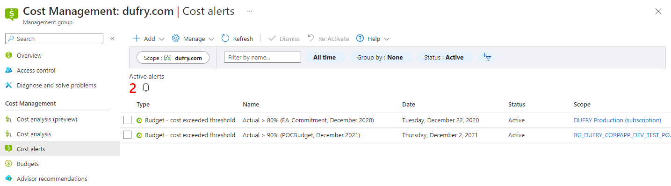
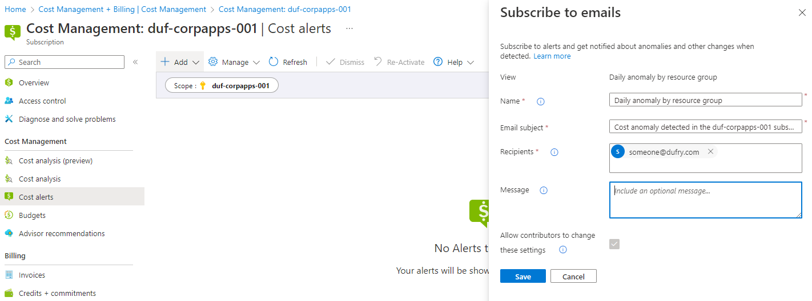
Cost governance – regular reviews: alerts
Cost Management alerts help to monitor Azure usage and spending. Cost alerts are automatically generated based when Azure resources are consumed. Alerts show all active cost management and billing alerts together in one place.
Monitor usage and spending with cost alerts in Cost Management - Microsoft Cost Management | Microsoft Learn
There is also possible to create a cost anomaly alert to automatically getting notification when an anomaly is detected.
Identify anomalies and unexpected changes in cost - Microsoft Cost Management | Microsoft Learn

Slide 10
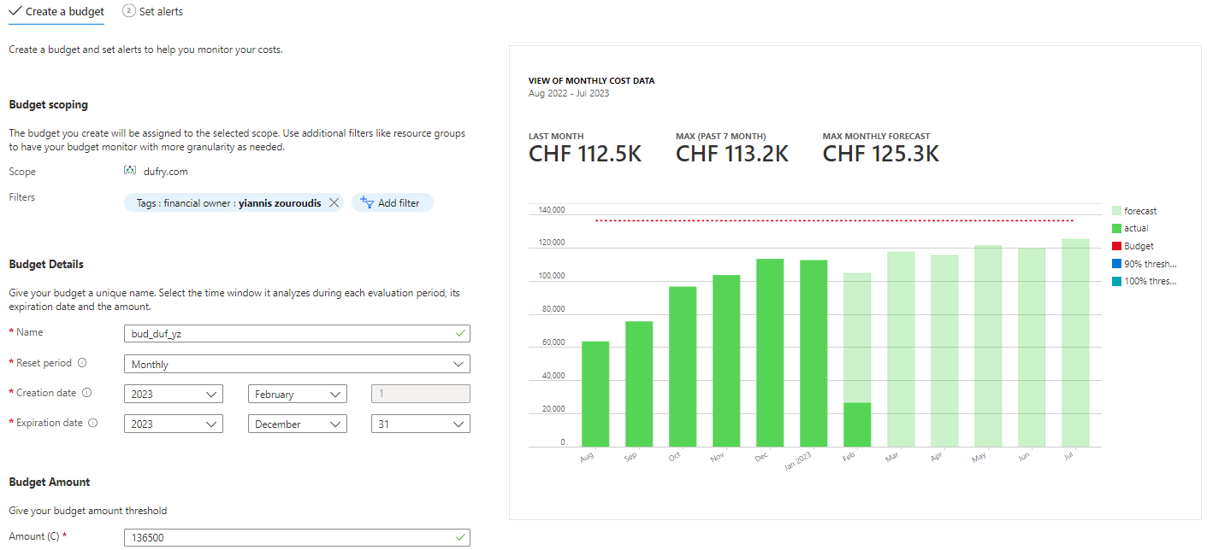
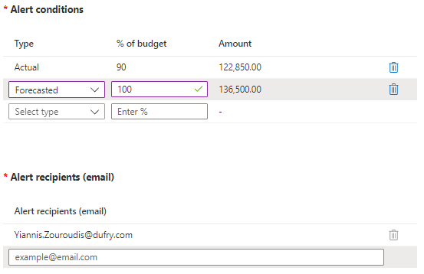
Cost governance – regular reviews: alerts from budgets
Remark:
Without budgets there is serious challenge to be informed about spending to proactively manage costs, and to monitor how spending progresses over time.

Slide 11
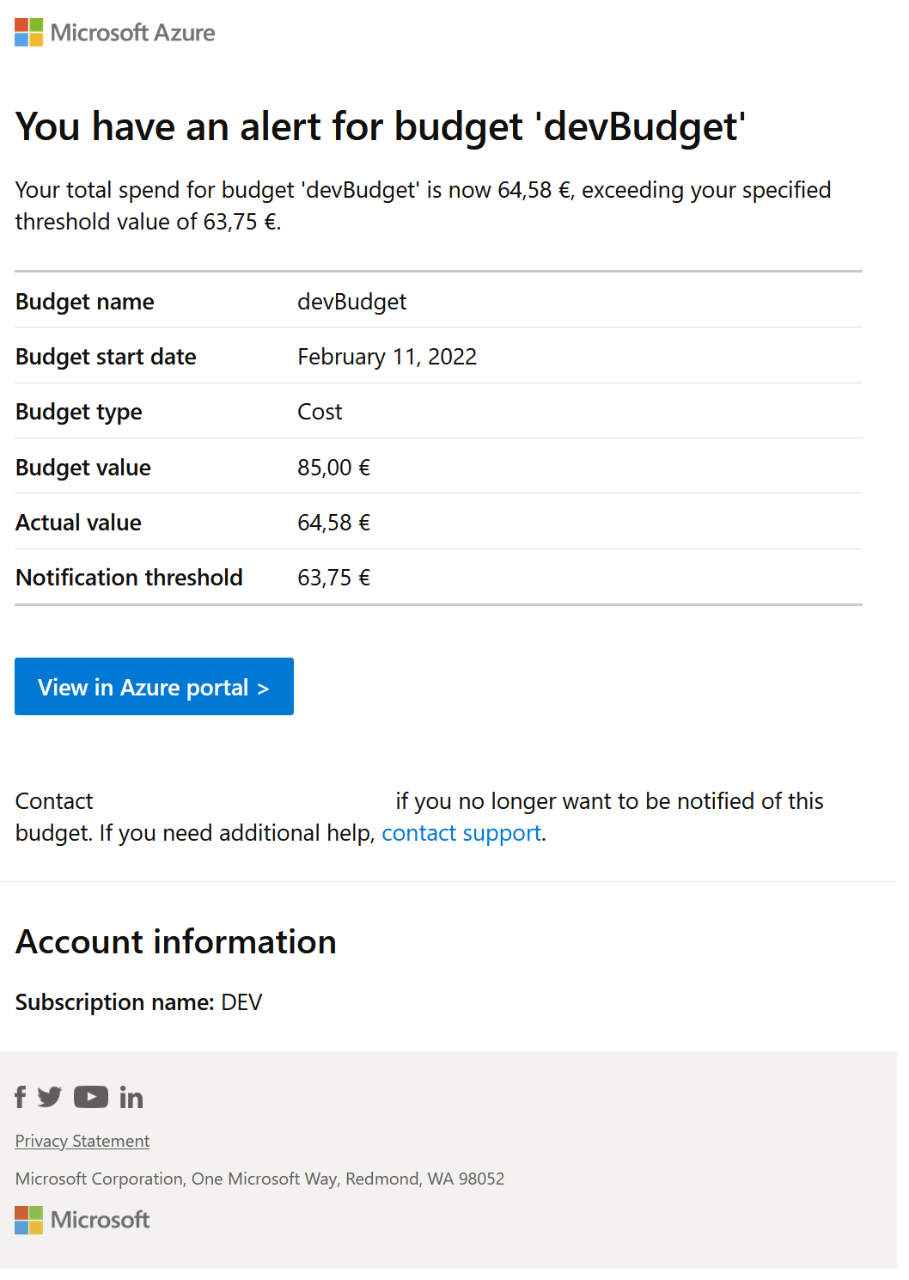
Cost governance – regular reviews: alerts from budgets > example e-mail message
Respond / take an action:
When an alert is received, there is need to check the current consumption data. Budget alerts aren't triggered in real time. There may be a delay between the alert and the current actual cost:
look for significant difference between cost values when the alert happened and the current cost
next, conduct a cost review to discuss the cost trend, possible causes, and any required action

Slide 12
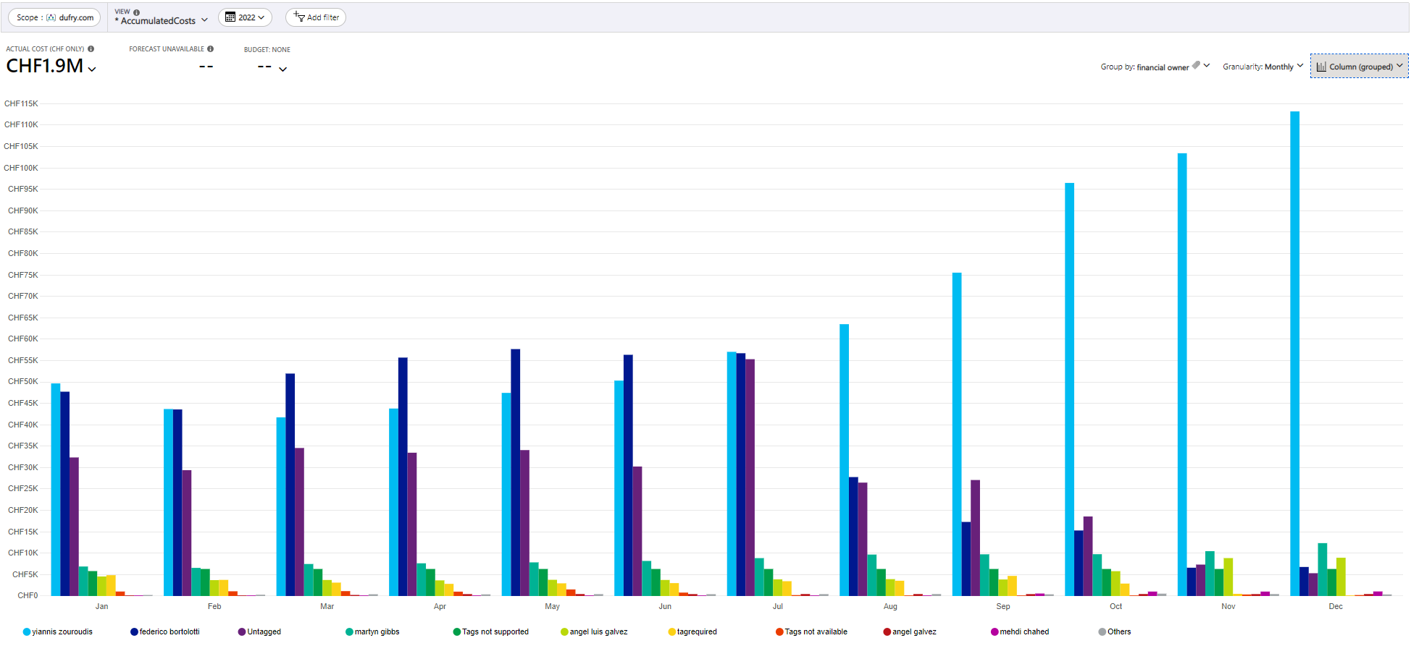
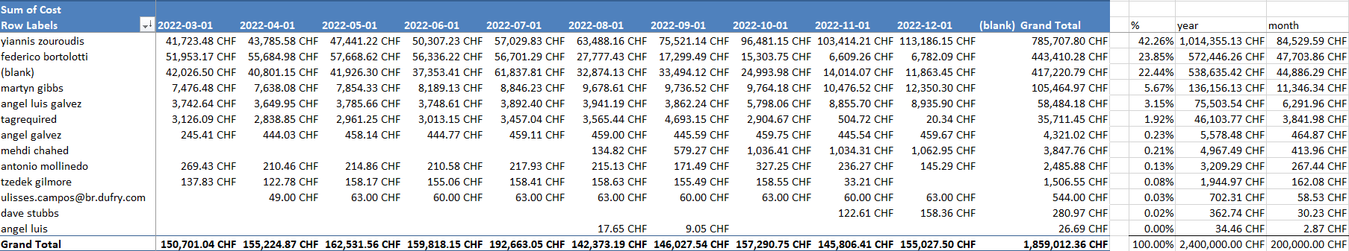
Cost governance – regular reviews: alerts from budgets (baseline: financial owners in 2022)

Slide 13
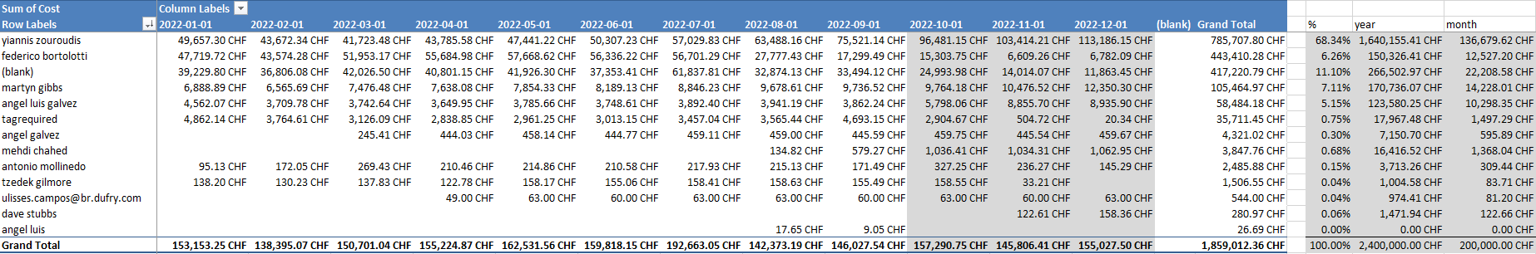
Cost governance – regular reviews: alerts from budgets (baseline: financial owners in Q4-2022)

Slide 14
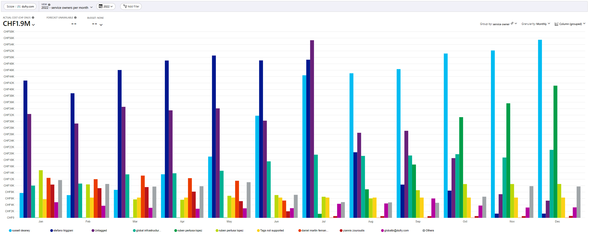
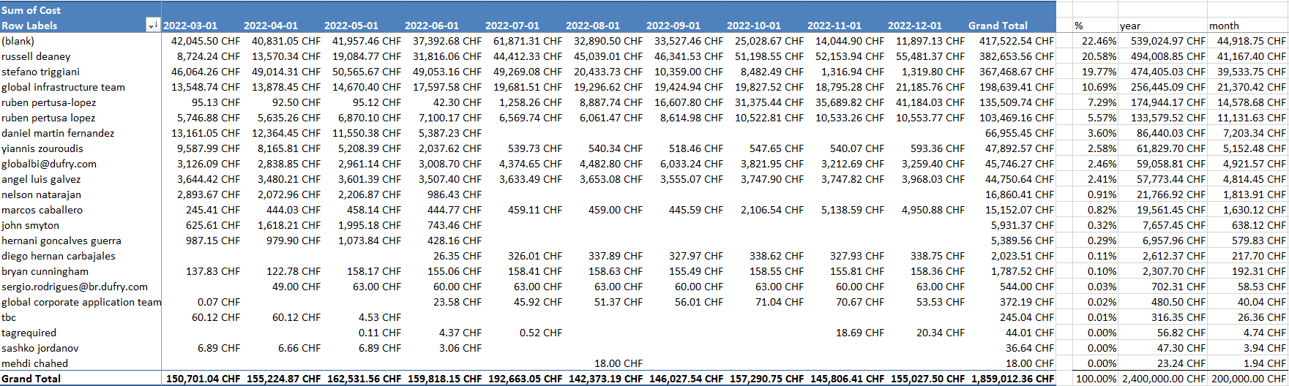
Cost governance – regular reviews: alerts from budgets (baseline: service owners)

Slide 15
Cost governance – regular reviews: alerts from budgets (setup)
Principals of Cost Management budged utilization:
budgets are used to inform financial owners about their spending to proactively manage costs, and to monitor how spending progresses over time
alerts based on actual and forecasted cost ensure spend is within organizational spend limit
when the budget thresholds are exceeded, only notifications are triggered
none of resources are affected and consumption isn't stopped
The following rules are used during budged threshold setup:
Scope | Filters | Name | Reset period | Budget amount ^{(*)} (% of participation in global budget) | Alert conditions | Alert recipient
dufry.com | Tags: Financial owner: Yiannis Zouroudis | bud_duf_corpapps | Billing month | 70% / 12 | Type: Actual, %: 90 Type: Forecast, %: 100 | Yiannis Zouroudis
dufry.com | Tags: Financial owner: Federico Bortolotti | bud_duf_erp | Billing month | 5% / 12 | Type: Actual, %: 90 Type: Forecast, %: 100 | Federico Bortolotti
dufry.com | Tags: Financial owner: Martyn Gibbs | bud_duf_infra | Billing month | 20% / 12 | Type: Actual, %: 90 Type: Forecast, %: 100 | Martyn Gibbs
dufry.com | Tags: Financial owner: Angel Luis Galvez Tags: Financial owner: Angel Galvez Tags: Financial owner: Angel Luis | bud_duf_security | Billing month | 2% / 12 | Type: Actual, %: 90 Type: Forecast, %: 100 | Angel Luis Galvez
dufry.com | Tags: Financial owner | bud_duf_storesystems | Billing month | 1.5% / 12 | Type: Actual, %: 90 Type: Forecast, %: 100 | Mehdi Chahed
dufry.com | Tags: Financial owner | bud_duf_audins | Billing month | 0.5% / 12 | Type: Actual, %: 90 Type: Forecast, %: 100 | Antonio Mollinedo
dufry.com | Tags: Financial owner: Tzedek Gilmore Tags: Financial owner: Dave Stubbs | bud_duf_adc | Billing month | 0.5% / 12 | Type: Actual, %: 90 Type: Forecast, %: 100 | Tzedek Gilmore Dave Stubbs
dufry.com | Tags: Financial owner: Ulisses Campos | bud_duf_storeapp | Billing month | 0.5% / 12 | Type: Actual, %: 90 Type: Forecast, %: 100 | Ulisses Campos
 |  |  |  | 100%
^{(*)} Calculation based on cost analysis of resource utilization in 2022 is available in SP: Dufry Hybrid Cloud > Documents > General > 07 Operations > Azure Financial Control > _analysis

Slide 16
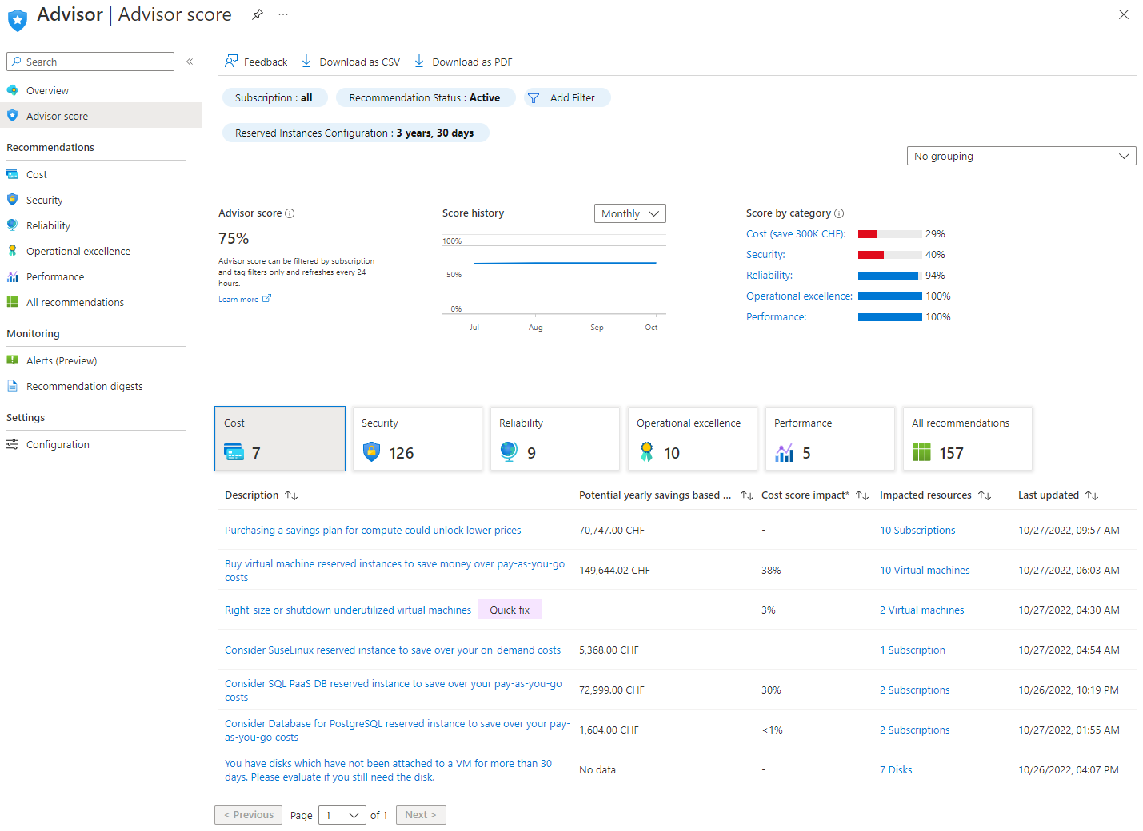
Cost governance – regular reviews: advisory
Azure Advisor helps to optimize and reduce overall Azure spend by identifying idle and underutilized resources. Cost recommendations can be taken from the Cost tab on the Advisor dashboard.
Reduce service costs using Azure Advisor - Azure Advisor | Microsoft Learn

Slide 17
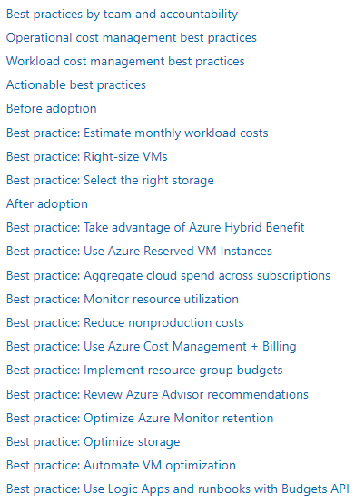
Cost governance – campaign reviews: best practice baseline
While delivering the disciplines of governance, cost management is a recurring theme at the enterprise level.
The following best practices are typically completed by a member of the cloud governance or cloud operations team, in accordance with patching and other scheduled maintenance processes.
Costing and sizing Azure resources - Cloud Adoption Framework | Microsoft Learn

Slide 18
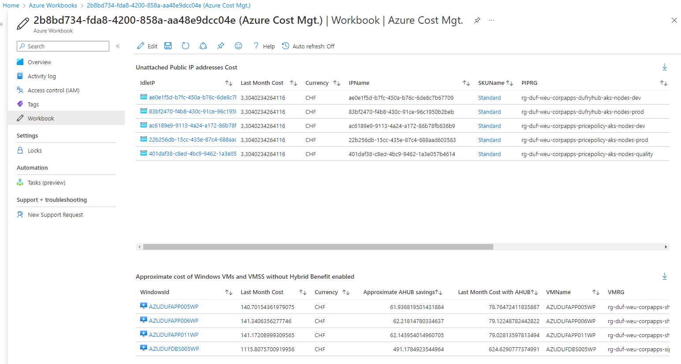
Cost governance – campaign reviews: Azure WAF Cost Assessment Workbook
While delivering the disciplines of governance, cost management is a recurring theme at the enterprise level.
The following best practices are typically completed by a member of the cloud governance or cloud operations team, in accordance with patching and other scheduled maintenance processes.
Azure WAF Cost Assessment Workbook automates detect discrepancy between best practice patterns and current workloads.

Slide 19
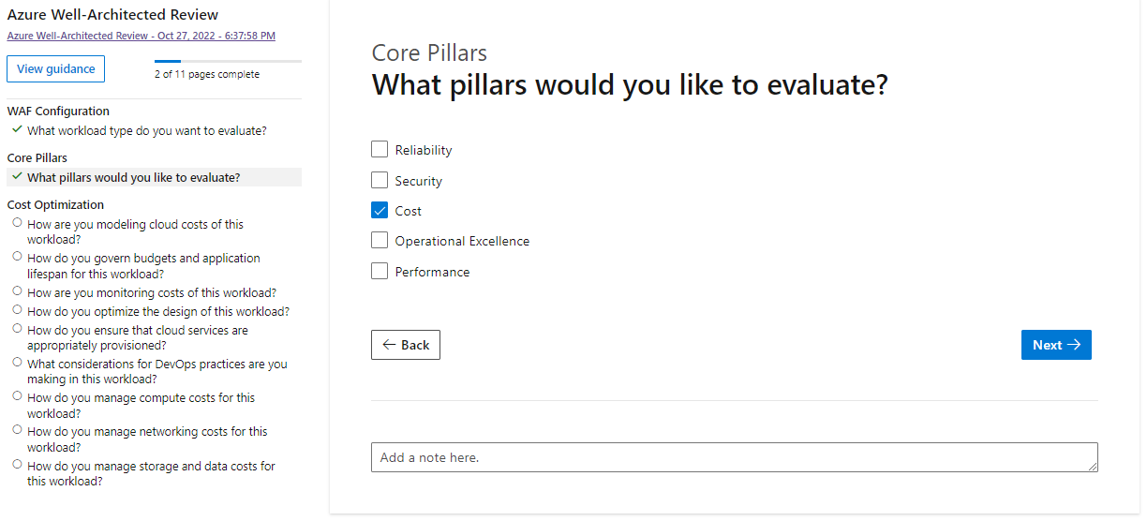
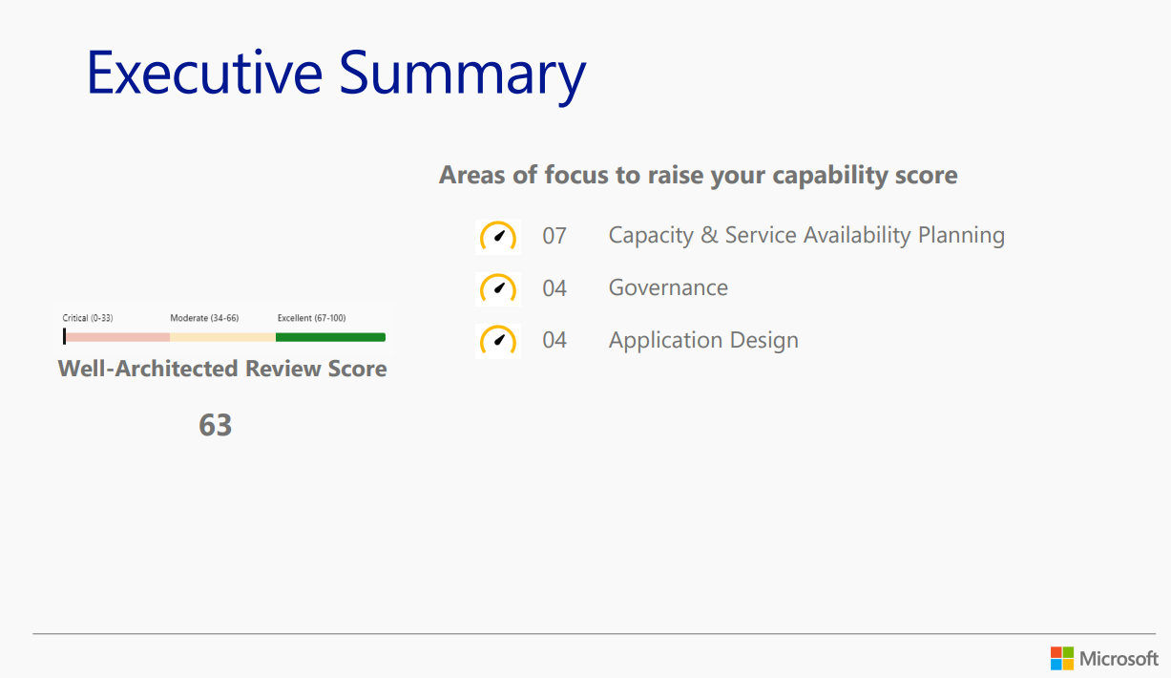
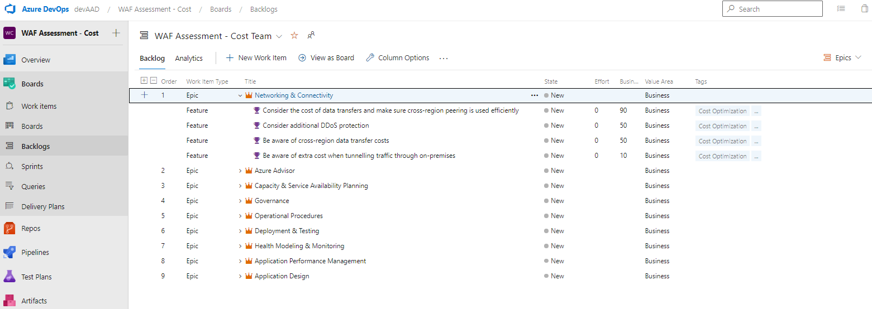
Cost governance – campaign reviews: Microsoft Assessment: Azure Well-Architected review
Allows to examine workload through the lenses of reliability, cost management, operational excellence, security and performance efficiency
Recommendation report
Azure DevOps recommendation import
Assessments | Microsoft Learn

Slide 20
Cost governance – action plan
Topic | Sub-topic | Responsibility | Target date | Progress
Regular review preparation | Financial control presentation | Infra Team / Financial owners | Jan-2023 | 25%
 | Feedback review | Infra Team | Jan-2023 | 0%
 | Budget setup | Infra Team | Jan-2023 | 0%
Campaign review preparation Review and prepare for application/service owners results and recommendations from “Azure WAF Cost Assessment Workbook” | Compute | Infra Team | Feb-2023 | 0%
 | Data | Infra Team | Feb-2023 | 0%
 | Storage | Infra Team | Feb-2023 | 0%
 | Networking | Infra Team | Feb-2023 | 0%
 | Monitoring | Infra Team | Feb-2023 | 0%
 | Performance | Infra Team | Feb-2023 | 0%
Feedback review Feedback and remarks from application/service owners about recommendations | duf_corpapps | App Teams | Feb-2023 | 0%
 | duf_erp | App Teams | Feb-2023 | 0%
 | duf_infra | App Teams | Feb-2023 | 0%
 | duf_security | Sec Team | Feb-2023 | 0%
 | bud_duf_storesystems | App Teams | Feb-2023 | 0%
 | bud_duf_audins | App Teams | Feb-2023 | 0%
 | bud_duf_adc | App Teams | Feb-2023 | 0%
 | bud_duf_storeapp | App Teams | Feb-2023 | 0%
Optimization Implement recommendations | Raise request | App Team | Q1-2023 | 0%
 | Implement request | Infra Team | Q1-2023 | 0%

Slide 21
Cost governance – RACI
Area | Activity | Infra Team | App owner | Financial owner
General cost management | Budget setup / (re-)configuration | R | I | A
On-boarding workload | Cost estimation | C | R | A
BAU | Policy compliance | R | A | I
 | Cost alert response based on budget threshold exceed | C | A | R
 | Cost alert response based on anomaly detection | R | A | I
 | Review advisory recommendations | R | A | I
 | Review discipline best practice | R | A | I
 | Cost analysis | C | A | R
Off-boarding workload | Revalidate Azure reservations | R | A | I
R = Responsible / A = Accountable / C = Consulted / I = Informed

Slide 22
3
Appendix

Slide 23
Appendix: Tools – cost estimation
Pricing Calculator | Microsoft Azure
Total Cost of Ownership (TCO) Calculator | Microsoft Azure
Azure Hybrid Benefit—hybrid cloud | Microsoft Azure
Azure VM assessments in Azure Migrate - Azure Migrate | Microsoft Learn
Cosmos DB Sizing Calculator
Azure Site Recovery Deployment Planner cost estimation report of Hyper-V - Azure Site Recovery | Microsoft Docs
Review cost estimations in the Azure Site Recovery Deployment Planner - Azure Site Recovery | Microsoft Docs

Slide 24
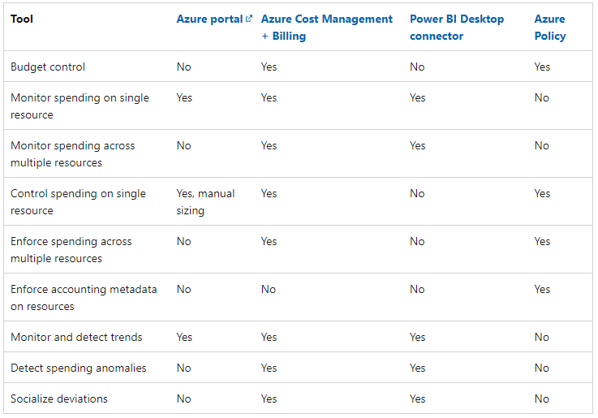
Appendix: Tools – cost operation
The following is a list of Azure native tools that can help mature the policies and processes that support:
establishing cloud spending plans
allocating cloud budgets
monitoring and enforcing cloud budgets
detecting costly anomalies
adjusting the cloud governance plan when actual spending is misaligned
Cost Management tools in Azure - Cloud Adoption Framework | Microsoft Learn
Reduce service costs using Azure Advisor - Azure Advisor | Microsoft Learn
Optimize Azure workloads by using Advisor Score - Azure Advisor | Microsoft Learn

Slide 25
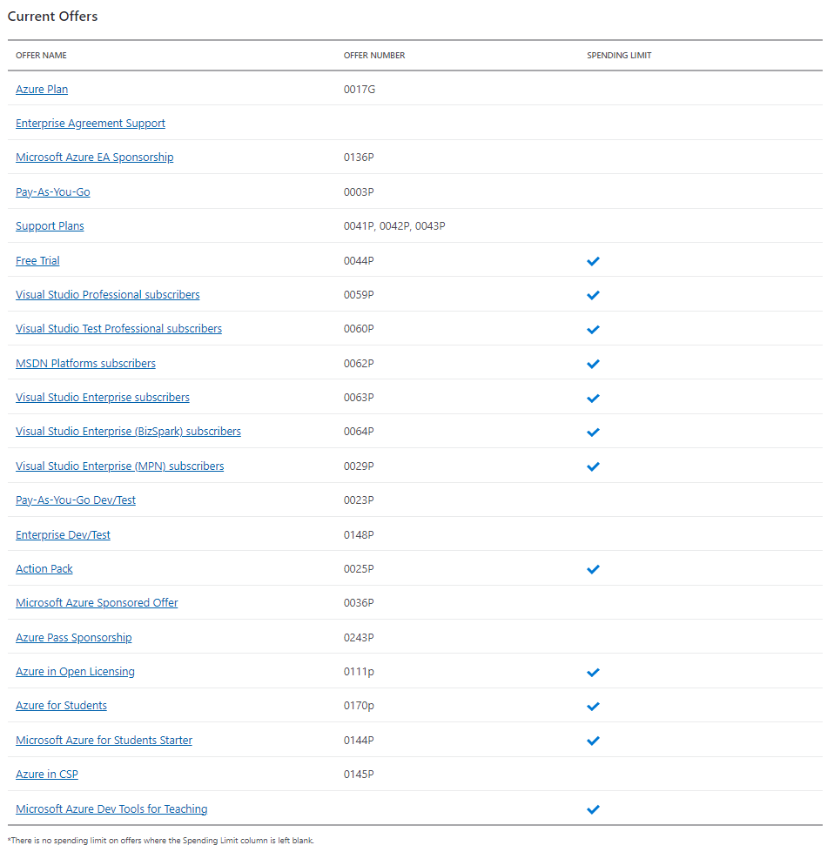
Appendix: Azure spending limit
The spending limit in Azure prevents spending over your credit amount.
All new customers who sign up for an Azure free account or subscription types that include credits over multiple months have the spending limit turned on by default.
The spending limit is equal to the amount of credit.
Offer Details | Microsoft Azure

Slide 26
Appendix: Integration
Cost Management automation can be used to build a custom set of solutions to retrieve and manage cost data:
Power BI App for Enterprise Agreements
Cost Management's Exports feature
The Usage Details API
Alerts and IT Service Management tools
Powershell Az.Billing and Azure CLI az billing
Manage Azure costs with automation | Microsoft Learn

Slide 27
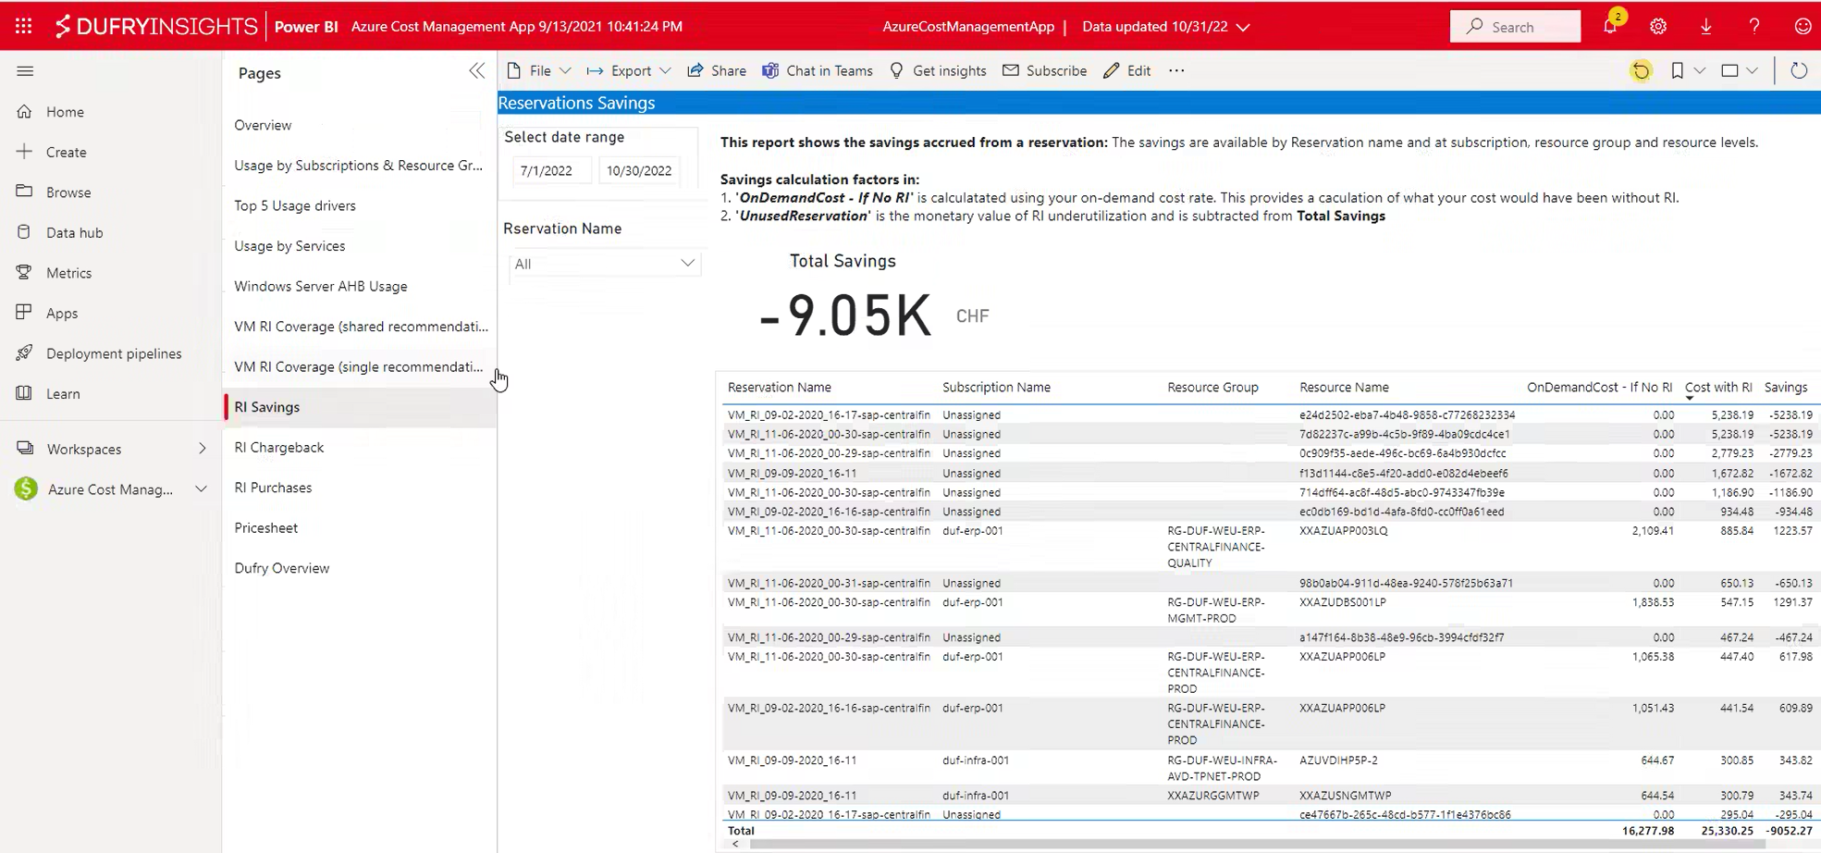
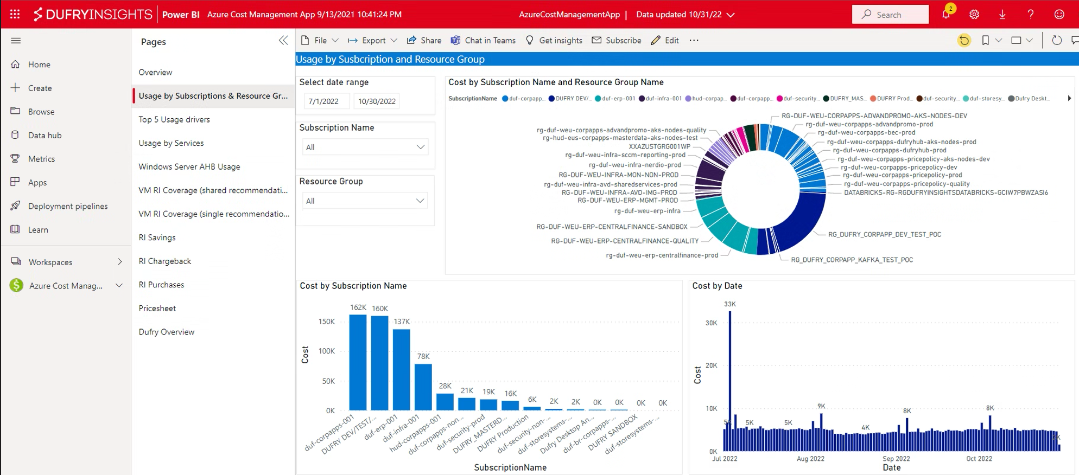
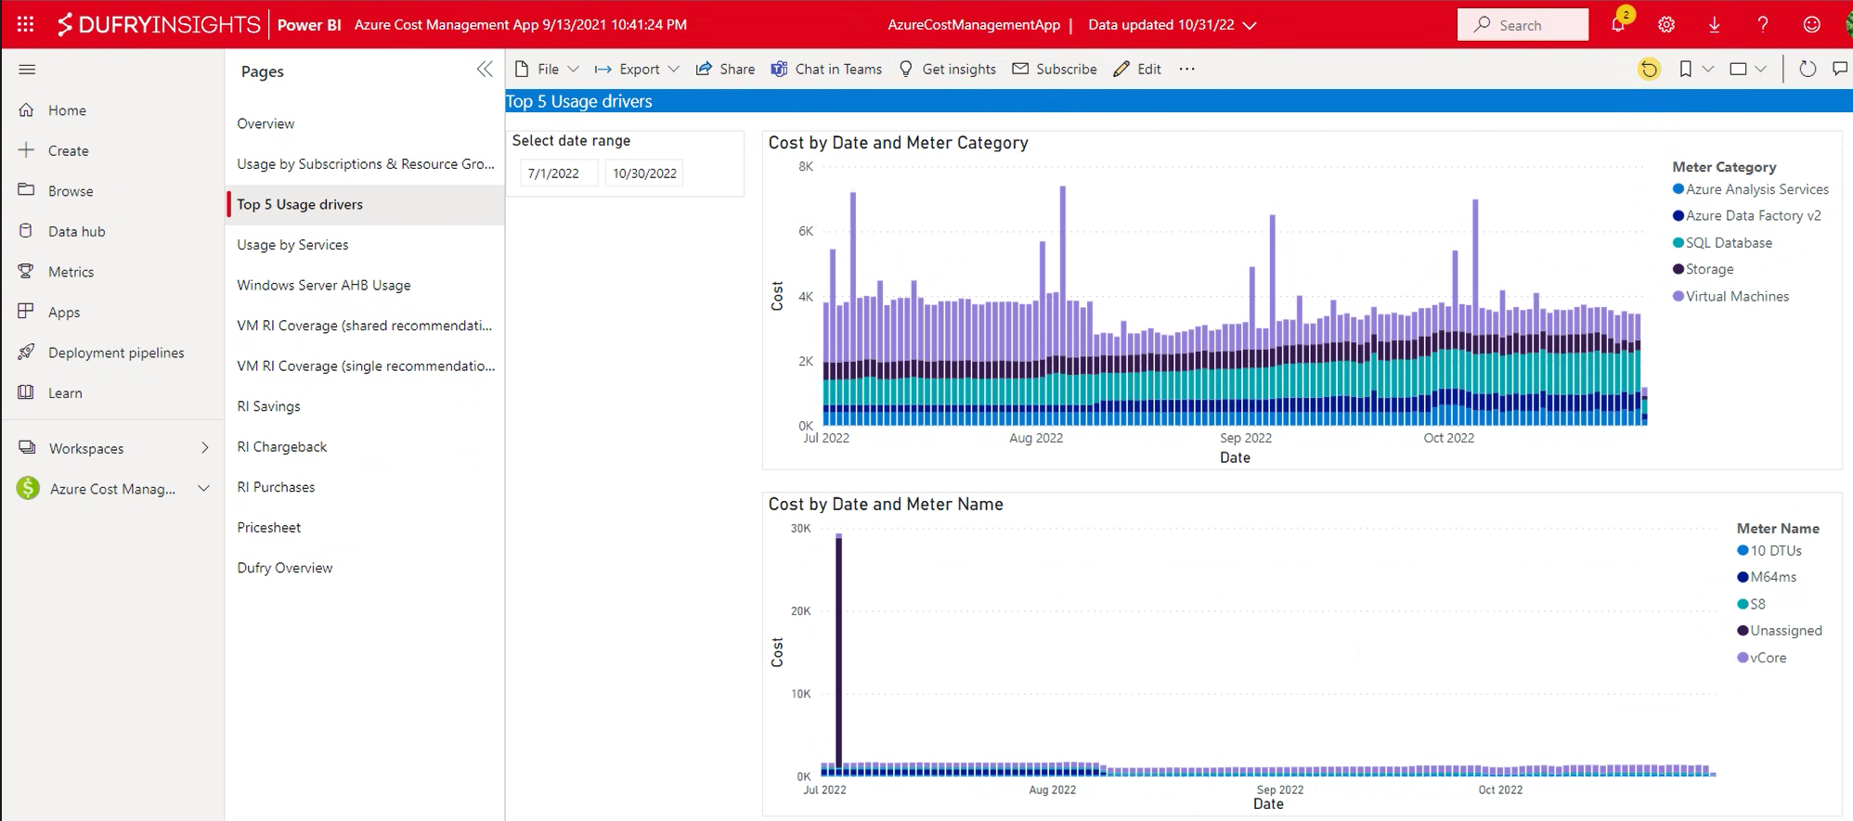
Appendix: Integration - Cost Management Power BI App for Enterprise Agreements
The app helps to analyze and manage your Azure costs in Power BI.
It can be used to:
monitor costs
usage trends
identify cost optimization options to reduce expenditures
Analyze Azure costs with the Power BI App | Microsoft Learn

Slide 28
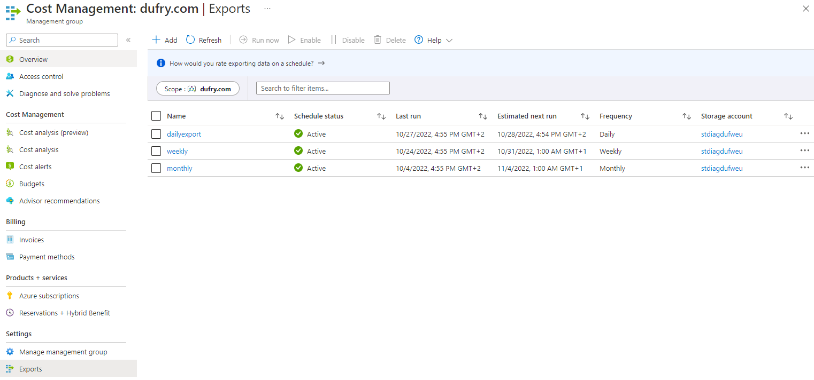
Appendix: Integration - Cost Management's Exports feature
Cost Management Export feature allows to create recurring task that automatically exports Cost Management data to Azure storage on a daily, weekly, or monthly basis.
Exported data is in CSV format and it contains all the information that's collected by Cost Management. It’s possible then to use the exported data in Azure storage with external systems and combine it with any custom data, also in an external system like a dashboard or other financial system.
Tutorial - Create and manage exported data from Cost Management - Microsoft Cost Management | Microsoft Learn
In addition to Azure Portal, exports are also available over:
Exports - REST API (Azure Cost Management) | Microsoft Learn
Az.CostManagement Module | Microsoft Learn

Slide 29
Appendix: Integration - Usage Details API
The Cost Management APIs provide the ability to explore cost and usage data via multidimensional analysis, where creating customized filters and expressions allow you to answer consumption-related questions for your Azure resources.
These APIs are currently available for Azure Enterprise customers.
Microsoft Cost Management REST APIs | Microsoft Learn
Azure Consumption REST APIs | Microsoft Learn
Azure Billing REST API | Microsoft Learn
Azure Consumption API overview | Microsoft Learn
Azure Enterprise Reporting APIs | Microsoft Learn

Slide 30
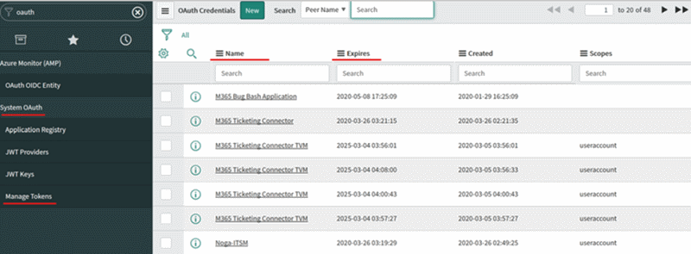
Appendix: Integration - Alerts and IT Service Management tools
Azure services like Azure Log Analytics and Azure Monitor provide tools to detect, analyze, and troubleshoot problems with your Azure and non-Azure resources. But the work items related to an issue typically reside in an ITSM product or service.
Azure Monitor provides a bi-directional connection between Azure and ITSM tools to help you resolve issues faster. You can create work items in your ITSM tool, based on your Azure alerts (Metric Alerts, Activity Log Alerts, and Log Analytics alerts).
IT Service Management integration - Azure Monitor | Microsoft Learn

Slide 31
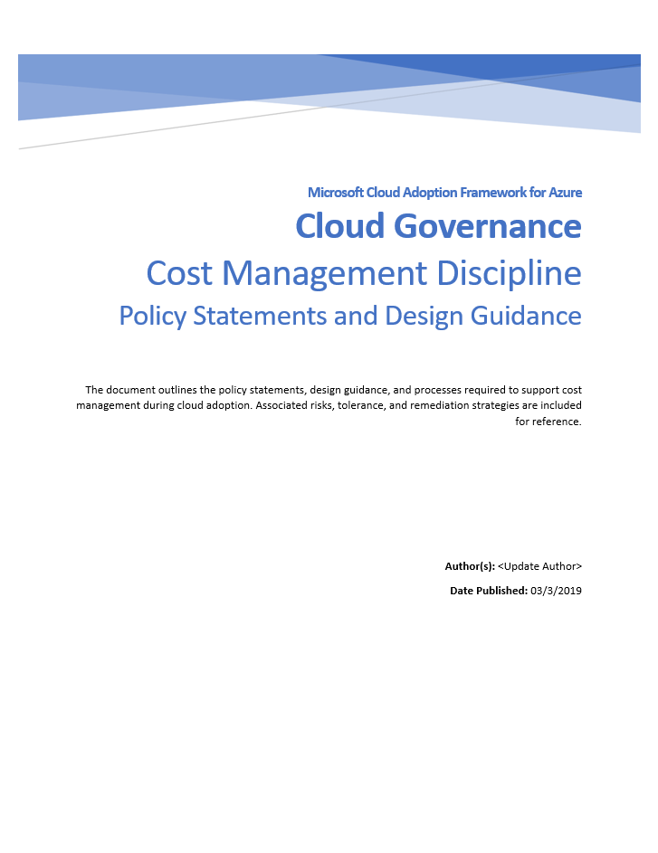
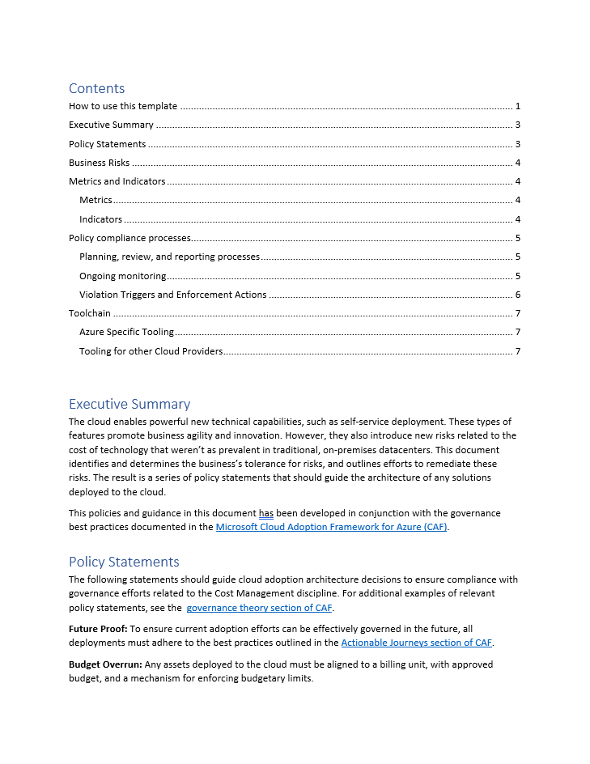
Appendix: Framework template
The following template serves as a starting point for documenting and communicating policy statements that govern cost management issues in the cloud.
Cost Management discipline template - Cloud Adoption Framework | Microsoft Learn
Template's structure can capture the business risks, risk tolerances, compliance processes, and tooling needed to define organization's Cost Management policy statements.

Slide 32
Appendix: Reference articles
Cost Management + Billing - Microsoft Cost Management | Microsoft Learn
Cost Management discipline overview - Cloud Adoption Framework | Microsoft Learn
Cost optimization documentation - Microsoft Azure Well-Architected Framework | Microsoft Learn
Training | Microsoft Learn
Control Azure spending and manage bills with Microsoft Cost Management and billing learning path - Training | Microsoft Learn
Configure subscriptions - Training | Microsoft Learn
Plan and manage your Azure costs (AZ-900) - Training | Microsoft Learn

Slide 33
Thank you

